Slide 1
“BREAKING THE WALLS OF QUARANTINE”
Smart mirror
Team members:
Jeevak Raj S
Aswath M

Slide 2
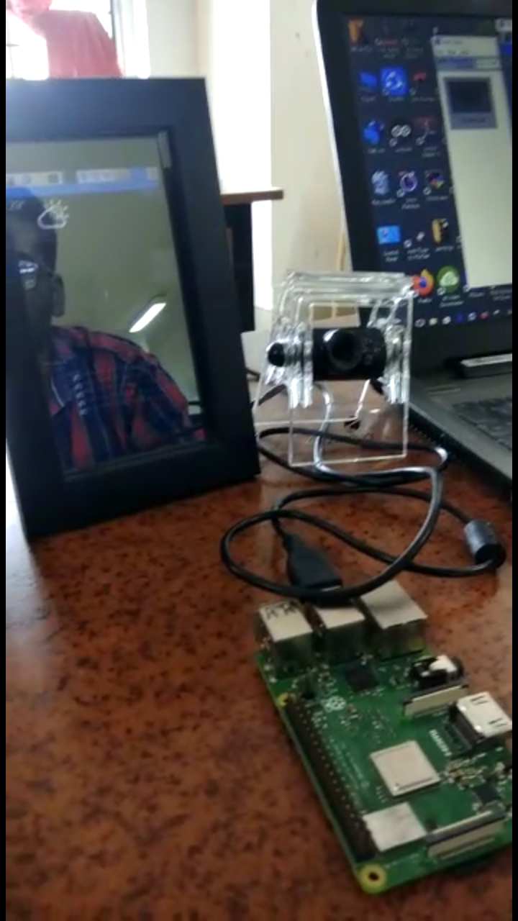
Introduction
Mirrors can be made more interactive, informative and entertaining than they are in today’s world. Instead of just a mere reflecting surface, they can be your personal assistant, provide you beauty tips, guide you in the makeup process, suggest you attractive spectacles and hairstyles, they could deliver personalized news feeds. The interactive voice assistant greets you and performs basic conversations; even play you themed songs based on the ambiance. The camera mounted on the mirror takes a live feed of the person, performs face recognition for personalization and detects facial landmarks to try-out spectacles and makeup tips. As people’s preferences are stored in the cloud and deep learning is performed on these data, the trained model is then retrieved by the mirror to give better suggestions.
In today’s pandemic situation going to shops and trying out clothes or spectacles is unhygienic so we can stay home and use these technologies and stay safe.

Slide 3
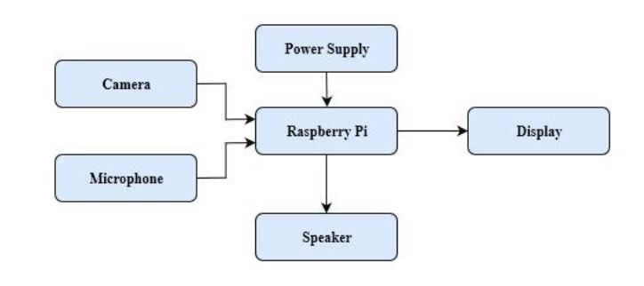
Schematic Diagram

Slide 4
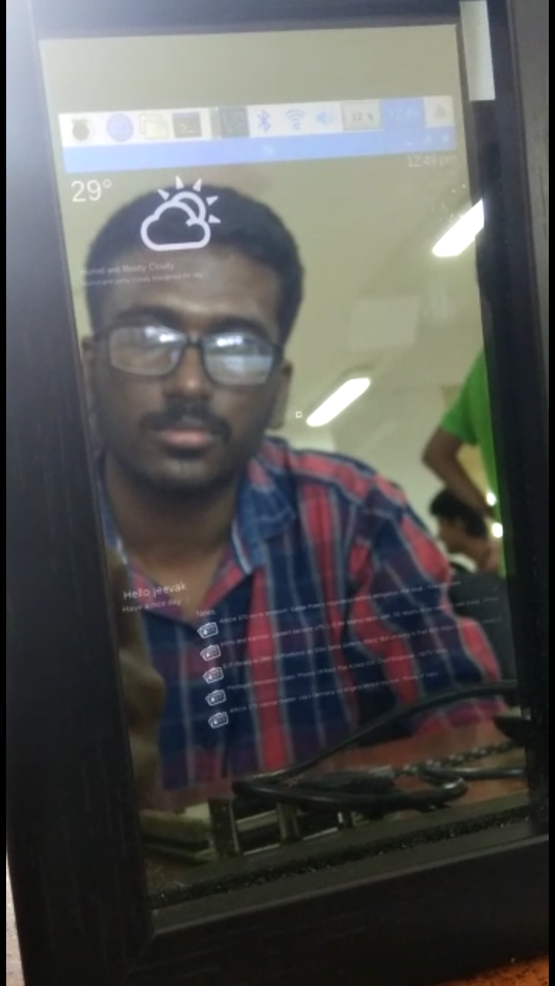
Description
The proposed Smart Mirror setup comprises of Camera, Raspberry Pi single board computer, LCD Display module, USB power supply, Keras and Tensor flow Deep learning models. The camera captures the scene in front of the mirror. The captured frame is processed in the Raspberry Pi to detect people. Facial recognition is performed and information related to the concerned individual is displayed. After this, the person is given a choice to try different fashion accessories. In case of spectacles, facial features are extracted and according to that, different choices of frames best suited for that individual is loaded and displayed. Using five point landmark detection, the spectacles are super imposed using the display on the reflection of the face. In case of clothing, the various joints of the person’s body parts is identified and different clothes are superimposed on those points, covering the actual reflection with display of the clothes. Patch-up and makeup guidelines can also be offered based on skin tones. Hairstyles can also be suggested based on face structures.

Slide 5
Features
1.Facial recognition is used to deliver personalized information (calendar events, news feeds) 2. Landmark detection on human body is used to superimpose fashion accessories such as outfits, clothes. 3. Deep learning model suggests different spectacles that suits one more appropriately. 4. Voice based interaction. 5. Playing themed music based on ambience and mood. 6. Suggestion of hairstyles based on face structure. 7. Suggestion of patch-ups, foundation and makeup tips to make one more attractive.

Slide 6
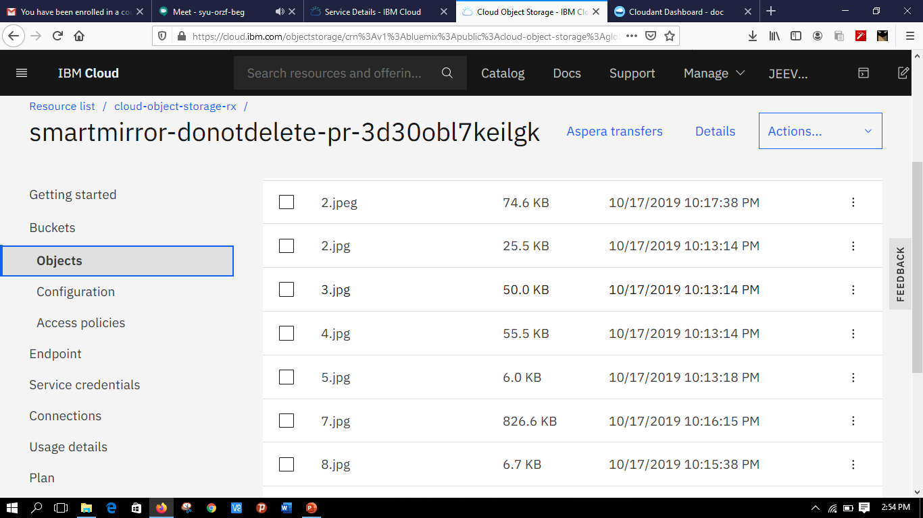
IBM Visual Recognition service

Slide 7
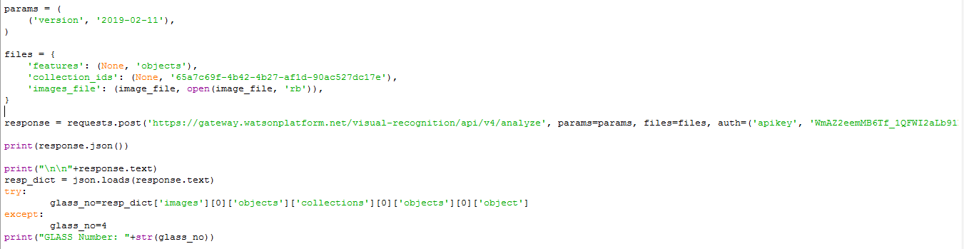
Implementation in python code

Slide 8
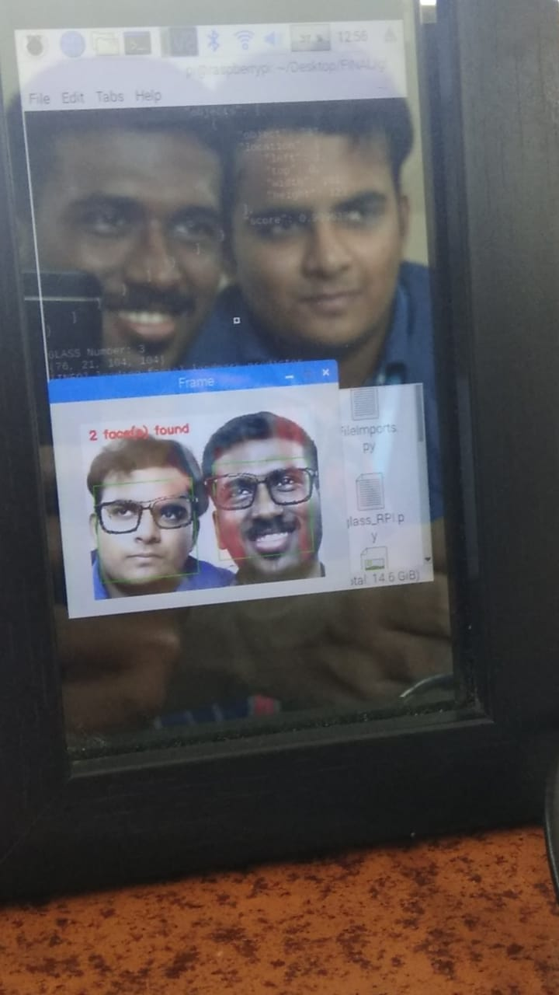
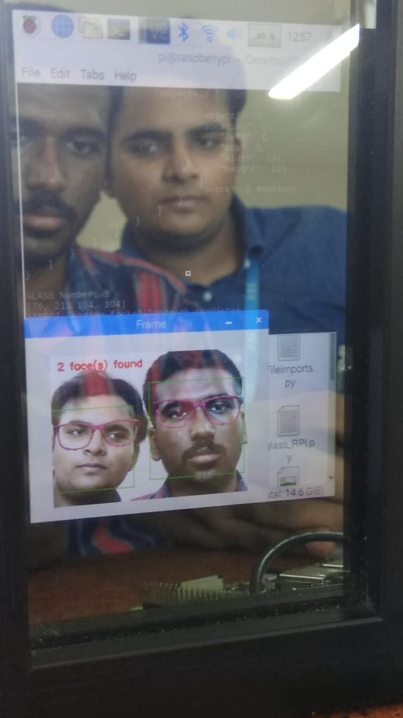
Outputs

Slide 9
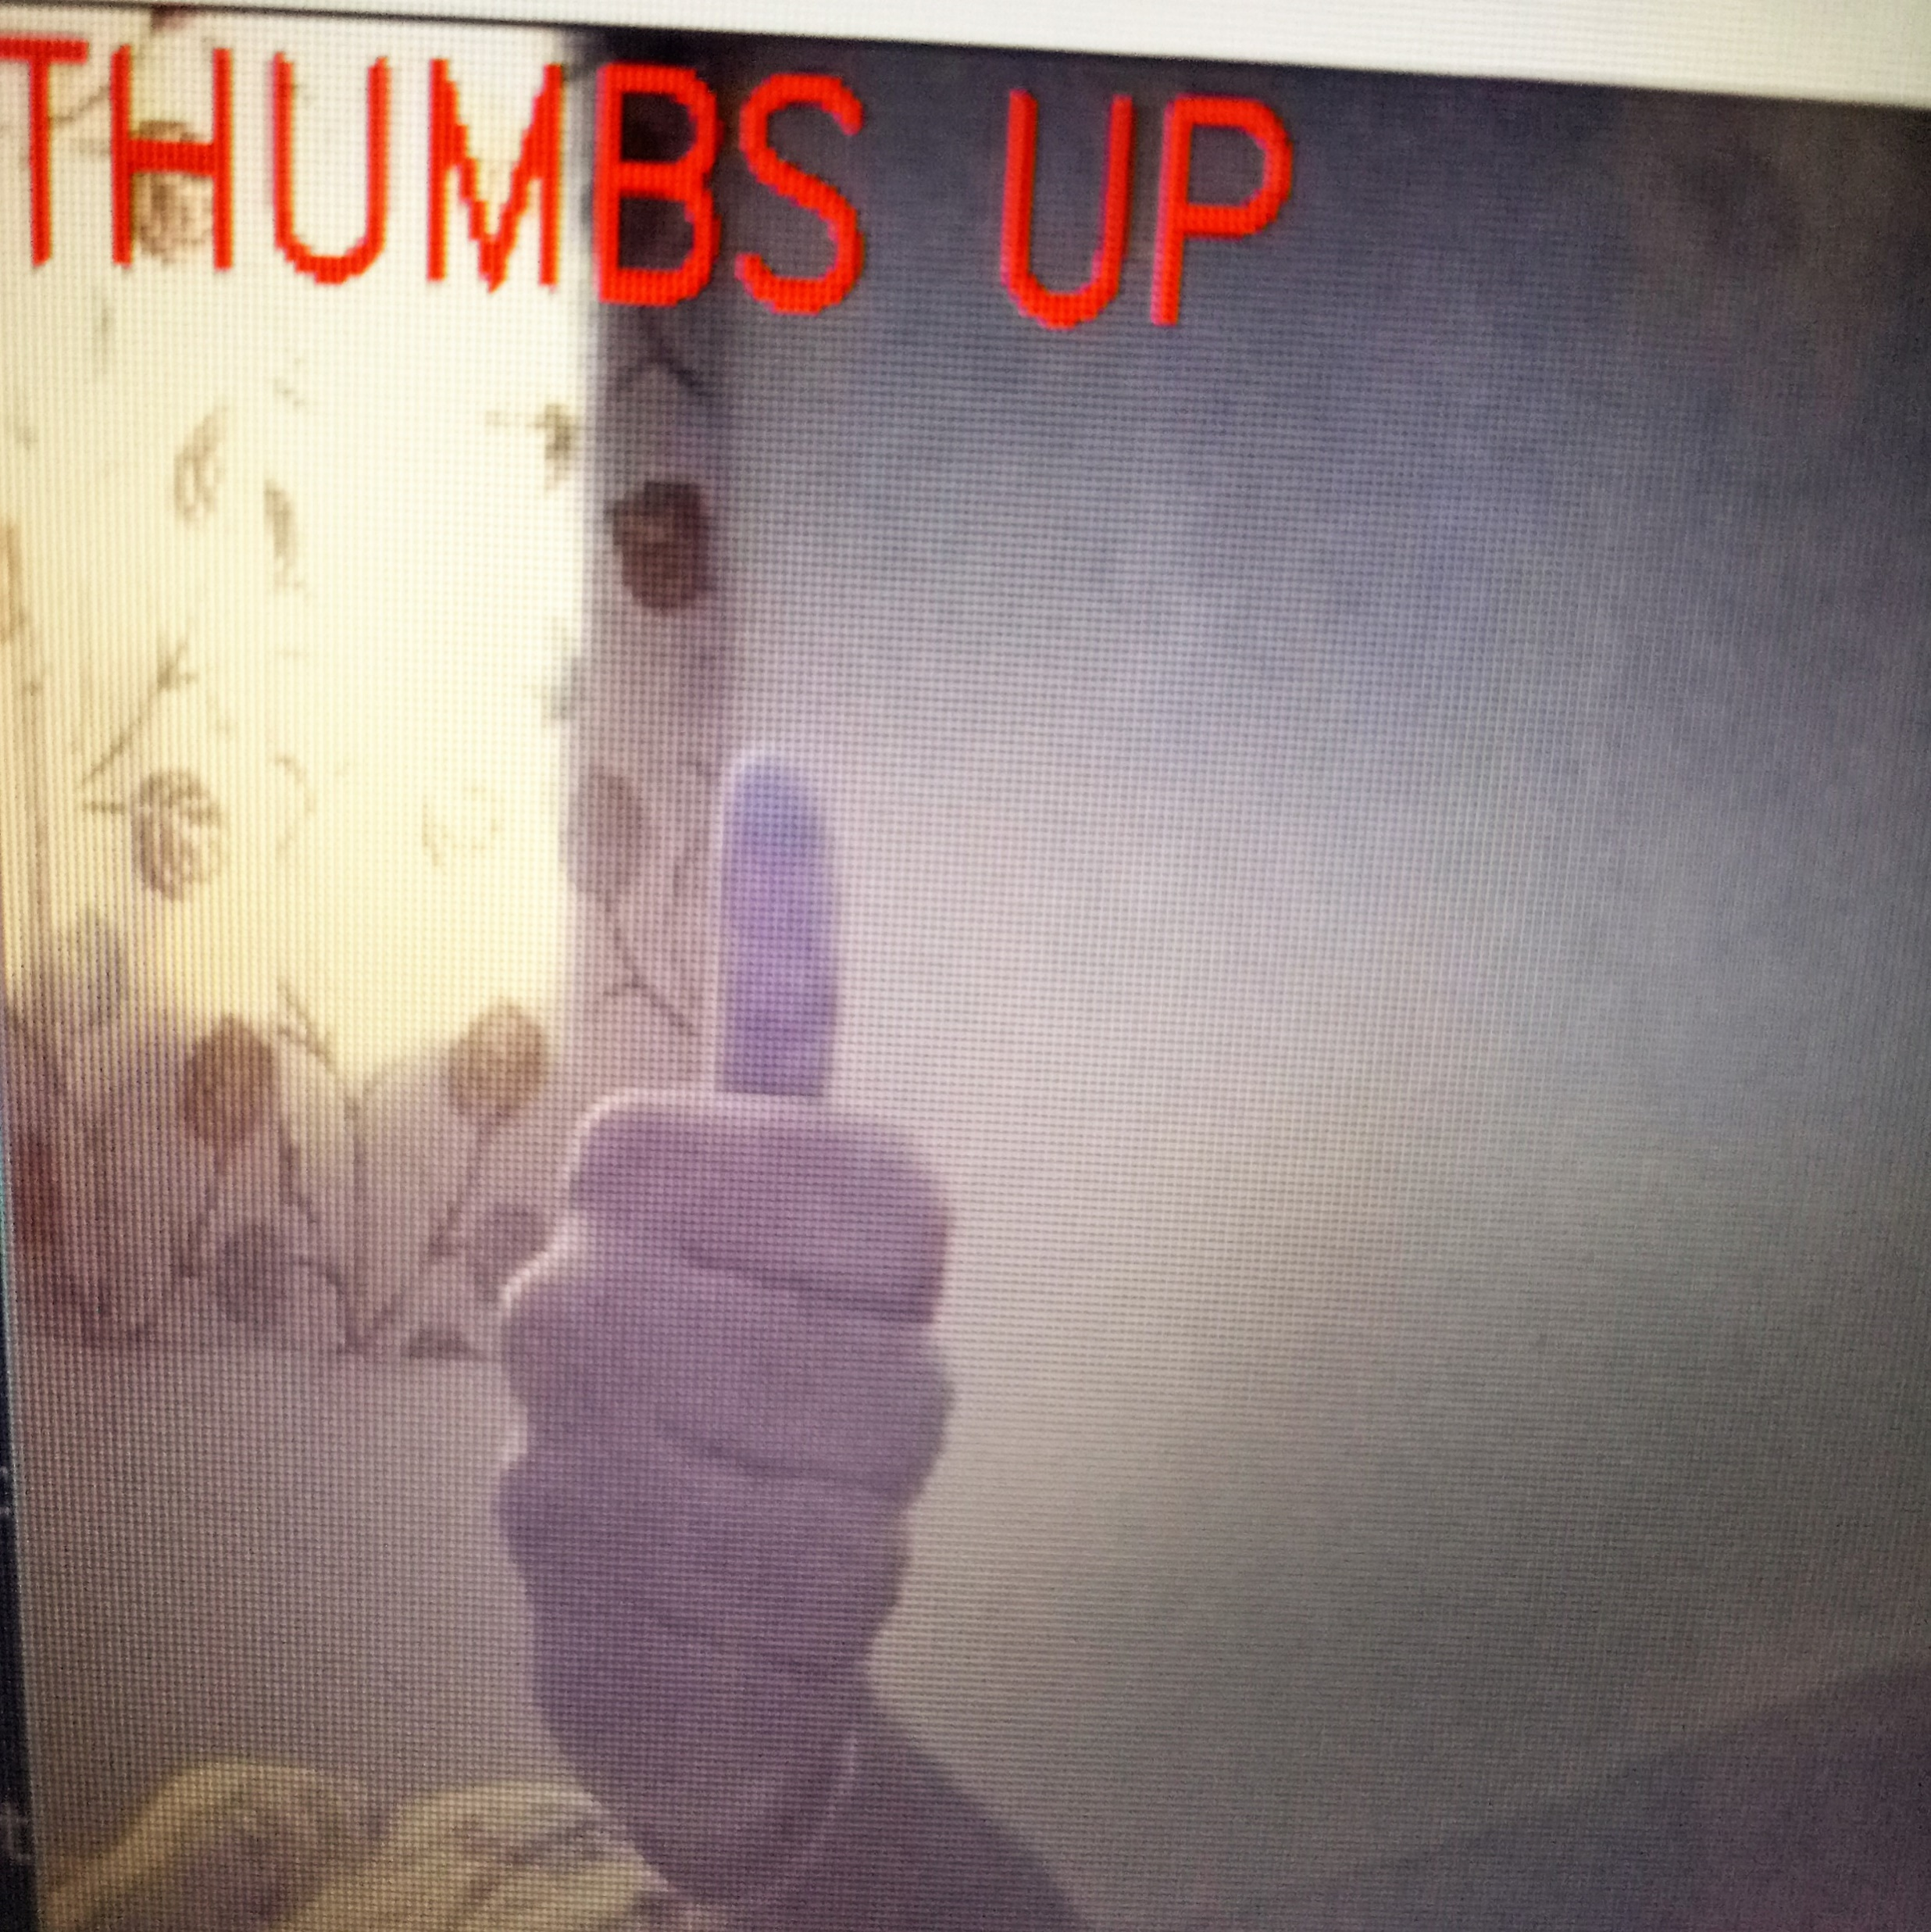
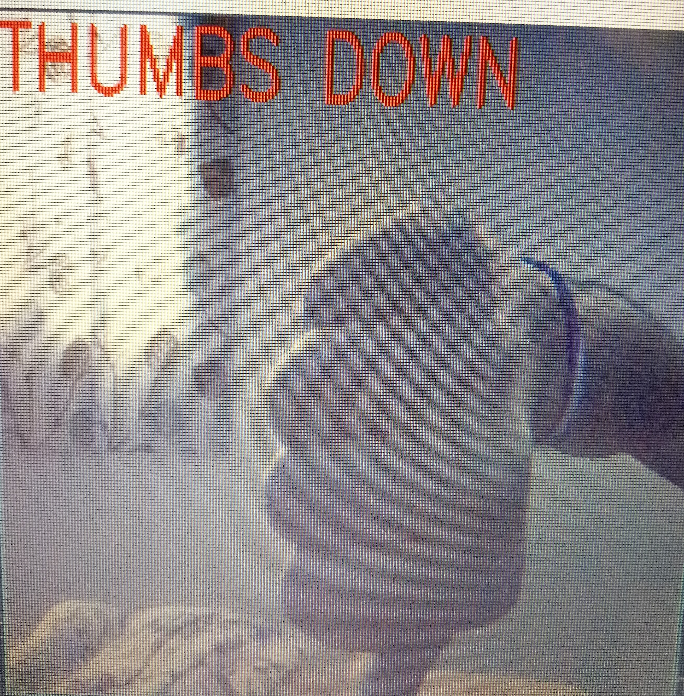
User’s Input

Slide 10
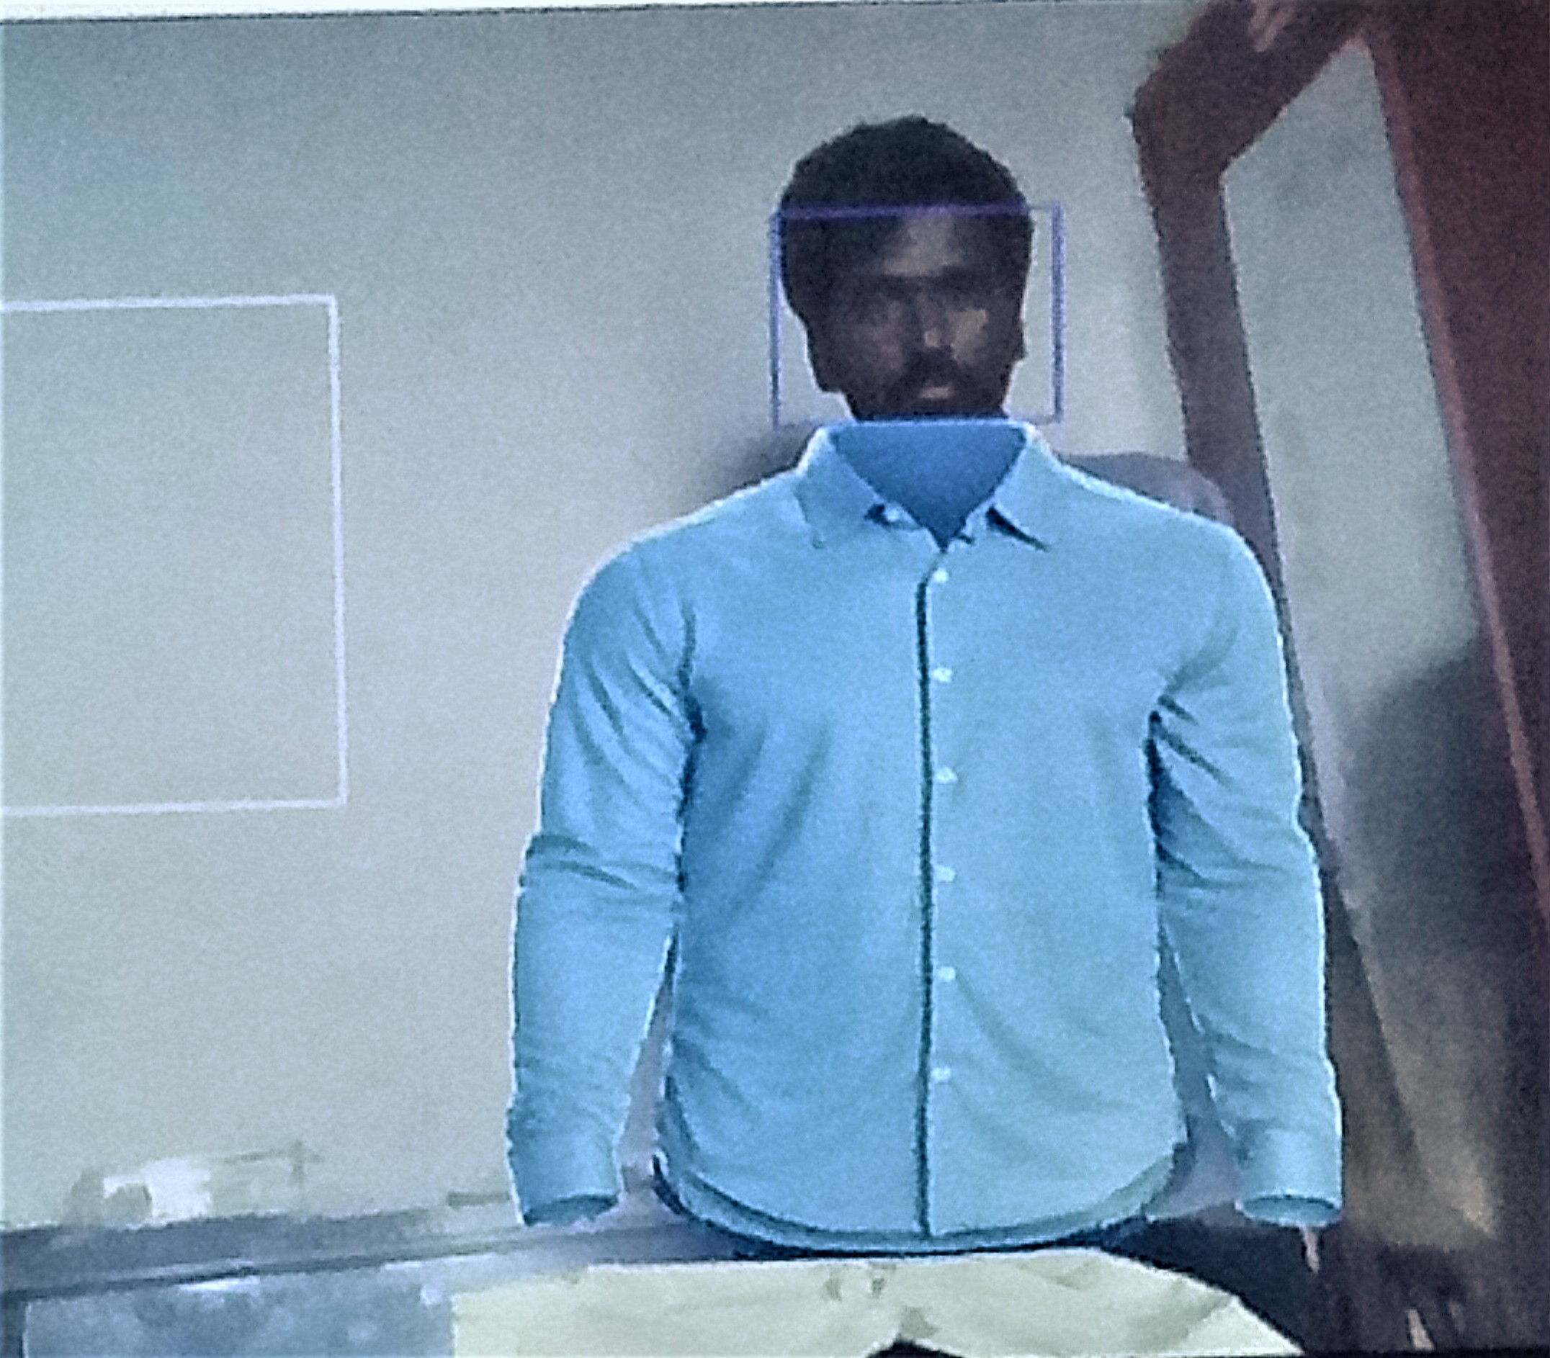
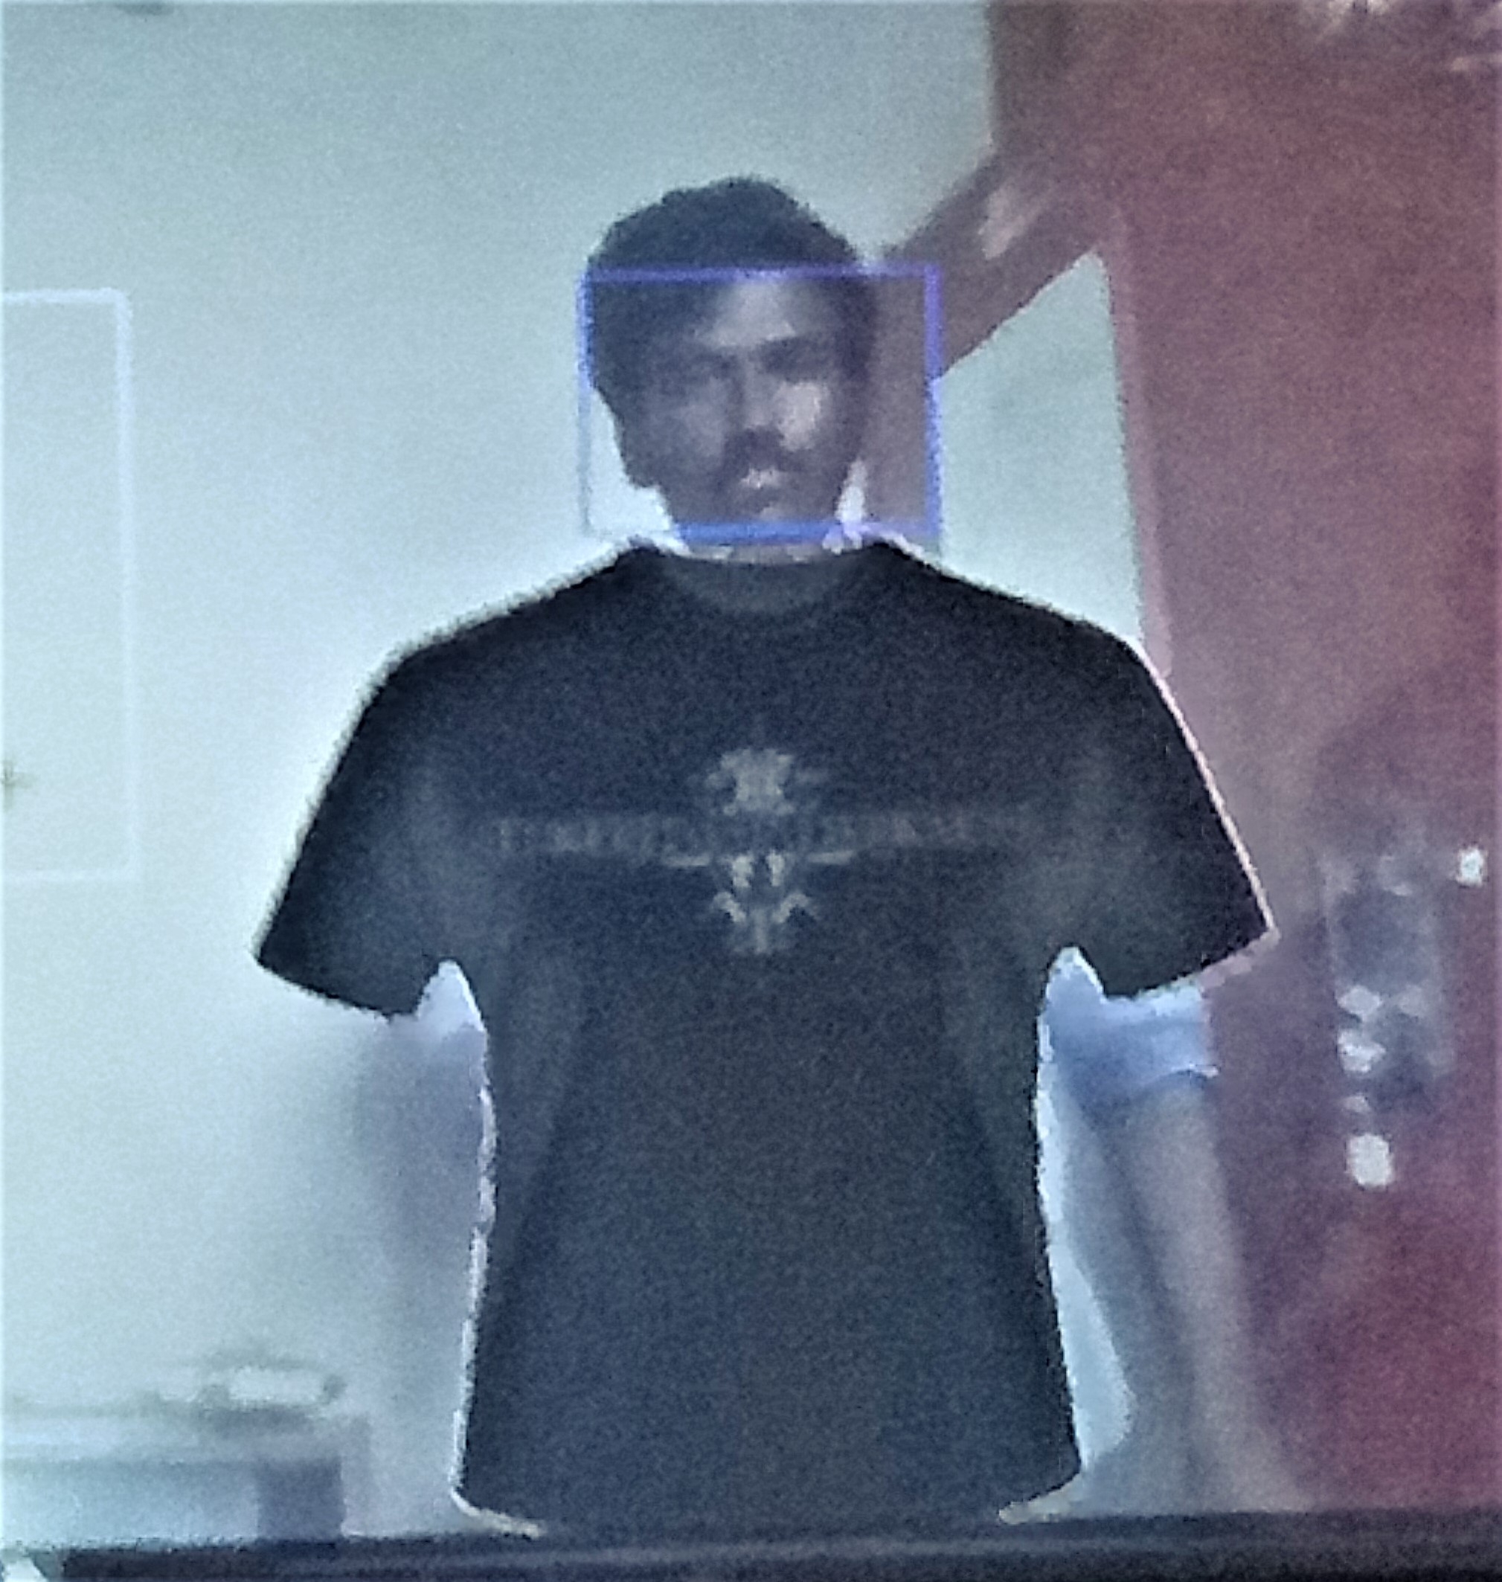
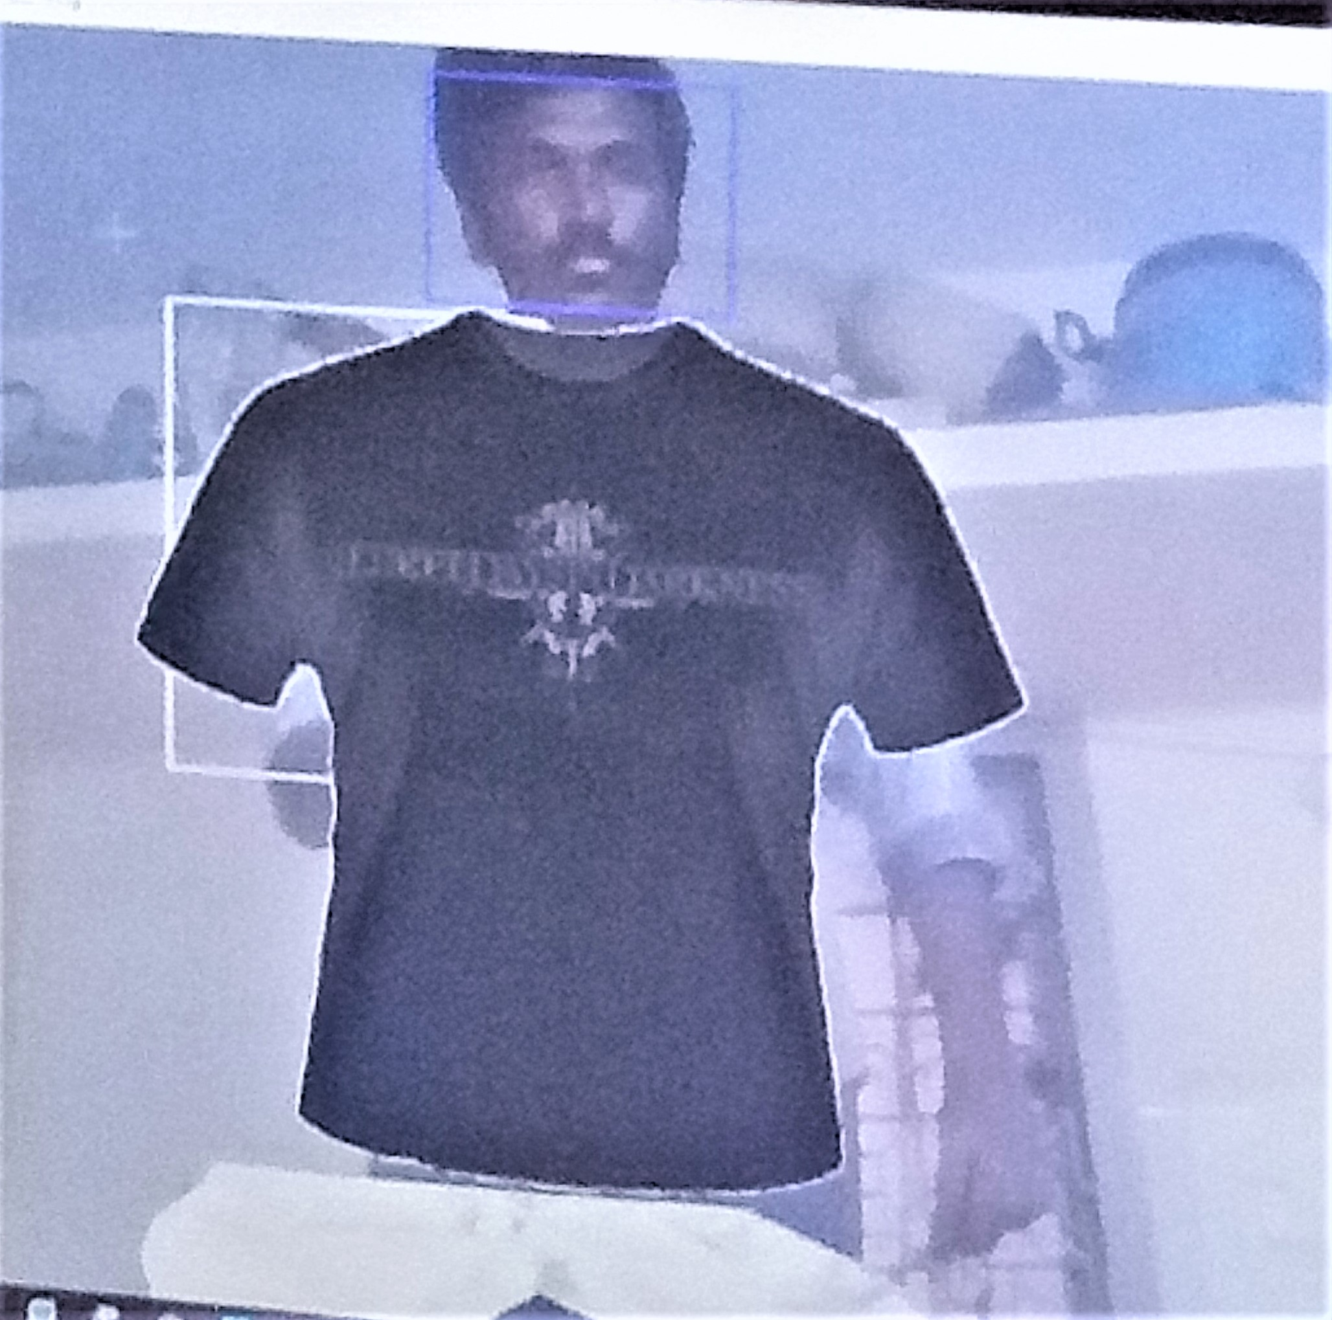
Changing Outfits

Slide 11
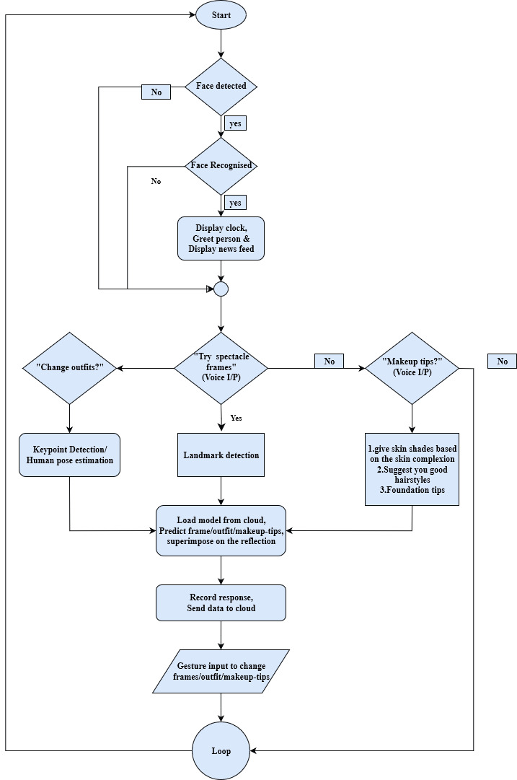
Flowchart

Slide 12
THANK YOU!

